Slide 1
بِسْمِ ٱللَّهِ ٱلرَّحْمَٰنِ ٱلرَّحِيمِ

Slide 2
Course: Web Designing
Institute: Corvit Systems Peshawar
Duration: 3-Month Web Designing & Development Course
1st class of JS (Java script)
Introduction to javascript

Slide 3
Instructor: Muhammad Sahil
BS in Computer Science – University of Peshawar
1 Year MERN Stack Developer – E Digital Pakistan (KPITB)
1 Year Web Instructor – E Digital Pakistan
6 Months Web Instructor – University of Peshawar
Computer Science Teacher – Alflah Model College, Sarband
Experience with multiple local client projects
Full Stack / MERN Stack Web Developer | Web Instructor

Slide 4
WHAT IS JAVASCRIPT !
JavaScript (JS) is a programming language used to:
Make websites interactive
Respond to user actions (click, type, scroll)
Change HTML and CSS dynamically
Perform calculations and logic
JavaScript gives life and functionality to websites.

Slide 5
HTML, CSS & JavaScript Relationship
HTML = Structure (Bones)
CSS = Design (Clothes)
JavaScript = Brain (Thinking & Actions)
All three work together to build modern websites.

Slide 6
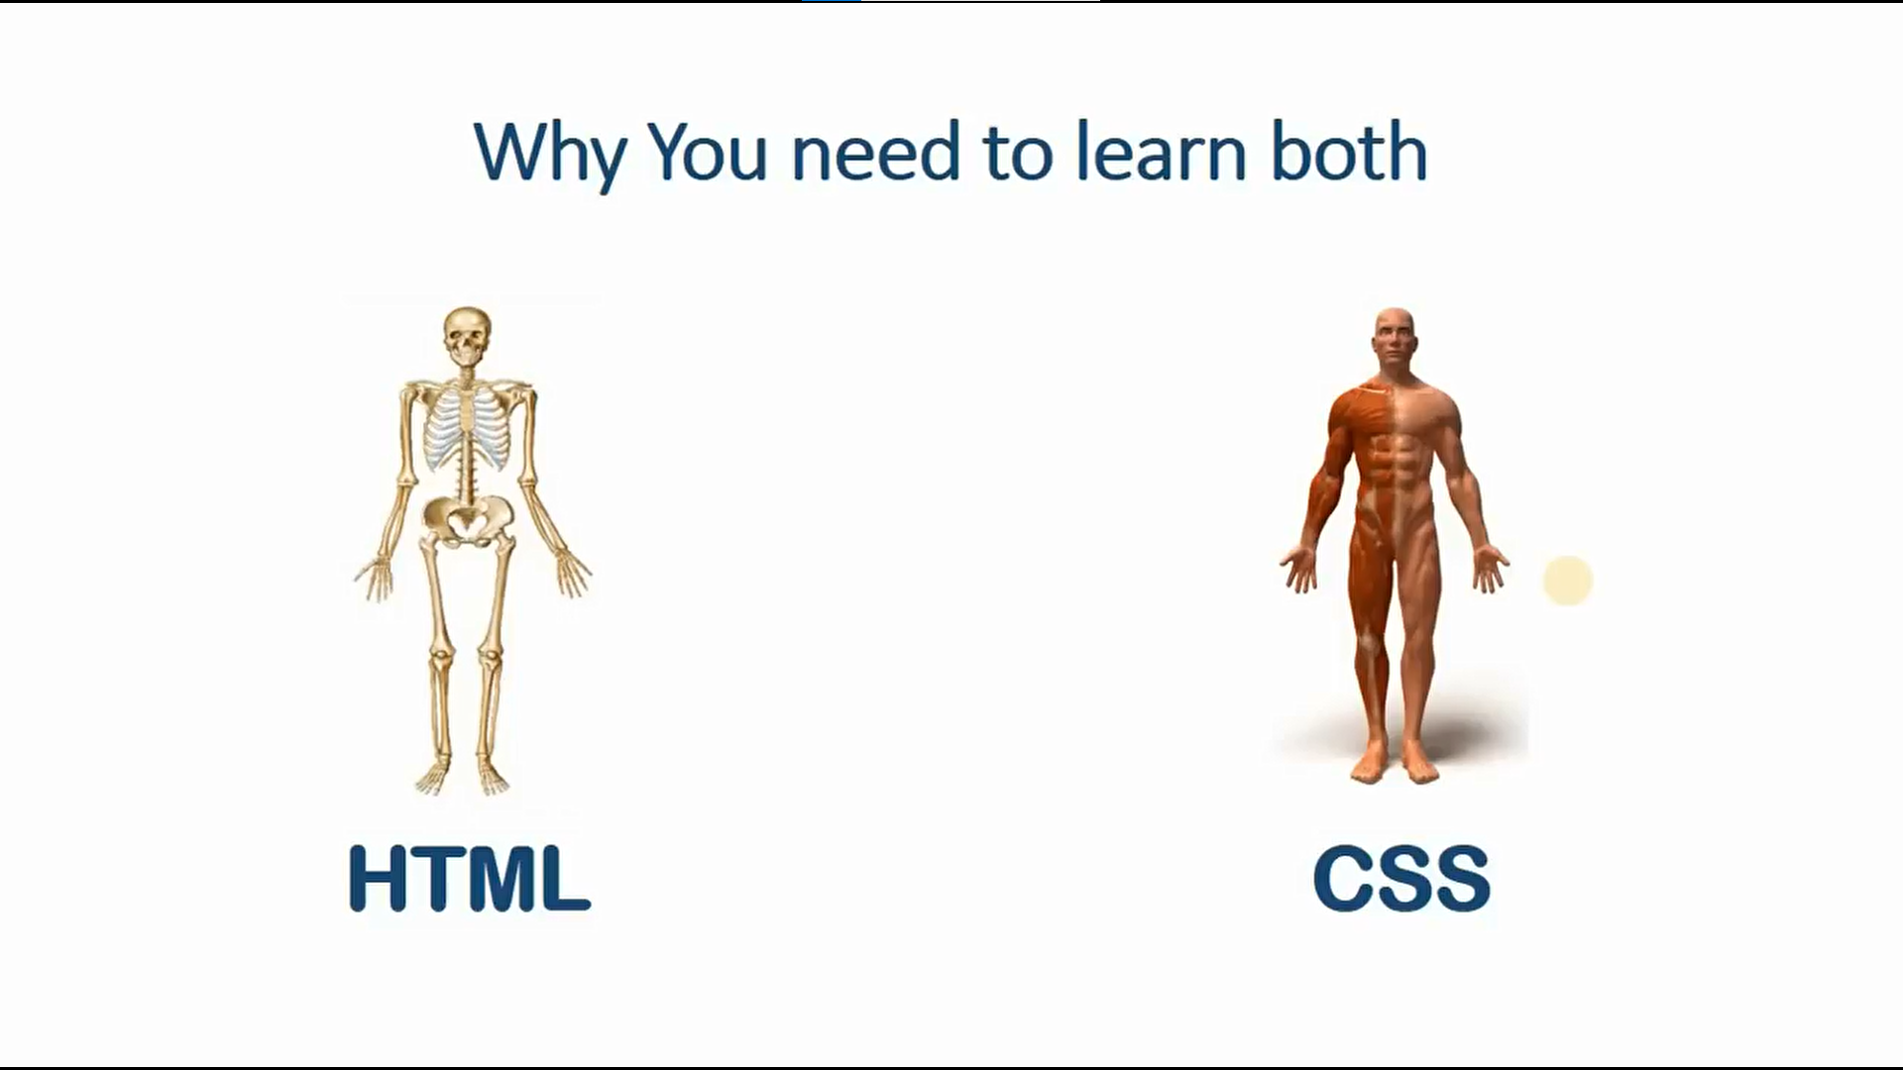

Slide 7
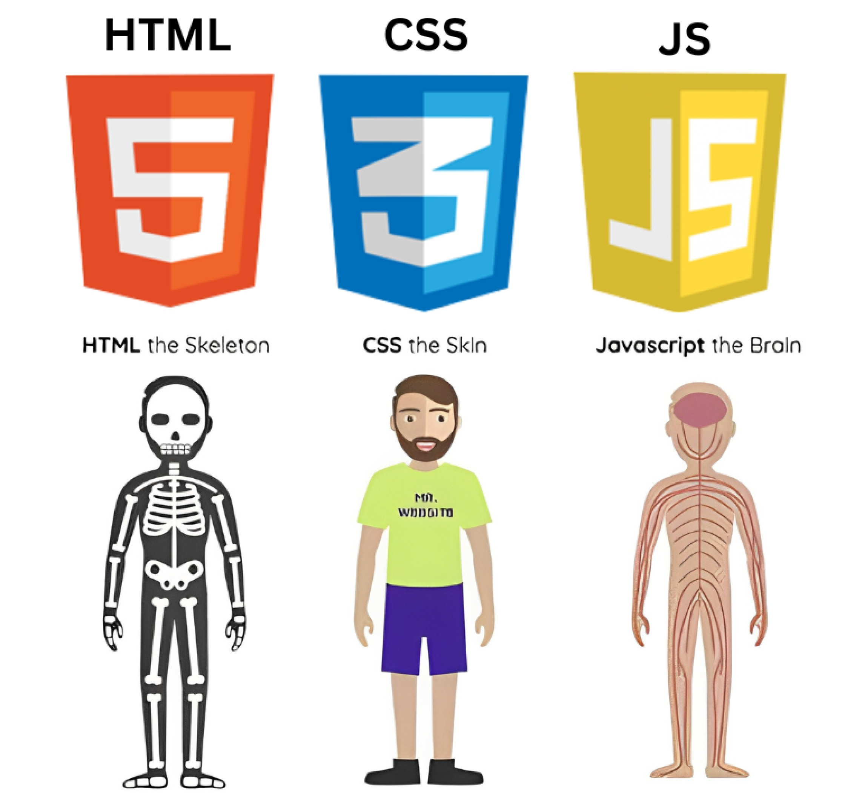
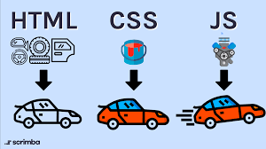
Importance of HTML, CSS, JavaScript

Slide 8
Website Without JavaScript
Website is static
Only text and images
No interaction
Buttons do nothing
Static websites cannot respond to users.

Slide 9
Website With JavaScript
With JavaScript:
Button work
Form validate input
Data updates without page reload
User-friendly experience
JavaScript makes websites dynamic and interactive.

Slide 10
Where is JavaScript Used .
JavaScript is used in:
Web browsers (Frontend)
Servers (Node.js Backend)
Mobile applications
Games
Desktop applications
JavaScript is one of the most powerful and popular languages.

Slide 11
How to Add JavaScript
There are three ways to add JavaScript:
Inline JavaScript
Internal JavaScript
External JavaScript
Each method has its own use case.

Slide 12
Inline JavaScript
Inline JavaScript:
Written directly inside HTML tags
Runs on user actions
Not recommended for large projects
Useful only for small demos
Example: Button click alert or prompt.

Slide 13
Internal JavaScript
Internal JavaScript:
Written inside <script> tag
Placed inside the same HTML file
Mostly used for learning and practice
Browser reads JavaScript line by line
Good choice for beginners.

Slide 14
JavaScript Comments
Comments are ignored by the browser.
They are used for:
Explanation
Notes
Debugging
Types of comments:
Single-line comment (// this is single line comment)
Multi-line comment (/*this is multilines
Comment you can write multitple lines */)

Slide 15
console.log( )
console.log( ) is used to:
Print output in browser console
Test code
Debug errors
Console is a developer tool.

Slide 16
How to Open Browser Console
Steps to open console:
Right-click on webpage
Click Inspect
Open Console tab
Used by developers to test JavaScript.

Slide 17
Variables in JavaScript
Variable is a container to store data.
Examples:
name = "Ali“
age = 20
Variables store numbers, text, and more.

Slide 18
Variable Keywords
JavaScript has three variable keywords:
var – Old, avoid using
let – Modern, recommended
const – Constant value

Slide 19
Data Types in JavaScript
Primitive data types include:
Number
String
Boolean
Undefined
Null
Used to represent different kinds of data.

Slide 20
typeof Operator
typeof checks the data type of a variable.
Examples:
typeof 10 → number
typeof "Sahil" → string
typeof true → boolean

Slide 21
Assigment

Slide 22
Summary
Today you learned:
JavaScript basics
Importance of JavaScript
Variables & data types

